Slide 1















BASIC DETAILS OF THE TEAM AND PROBLEM STATEMENT
MINISTRY/ORGANIZATION NAME : MINISTRY OF HOUSING AND URBAN AFFAIRS
PS CODE : SIH1516
PROBLEM STATEMENT TITLE : SUGGEST AN AI BASED SOLUTION TO ENABLE EASE OF GRIEVANCE LODGING AND TRACKING FOR CITIZENS ACROSS MULTIPLE DEPARTMENTS
TEAM NAME : PANDA PIRATES TEAM LEADER NAME : MEGHA JAIN
TEAM MENTOR NAME : MS. REKHA BAGHEL
INSTITUTE CODE : 027 AISHE CODE : C-46109
INSTITUTE NAME : AJAY KUMAR GARG ENGINEERING COLLEGE
THEME NAME : SMART AUTOMATION
IDEA AIM
In our project, we need to address the challenge citizens face in navigating government grievance redressal, including the registration of complaints in the wrong department, leading to application rejections.
Citizens often struggle to identify the appropriate department for filing grievances and face difficulties in registration and tracking.
Aim: Our goal is to simplify grievance redressal by creating a user-friendly platform featuring an AI bot that guides users, offers clear instructions, and promotes transparency in governance.
DEPARTMENTS
SOLUTION APPORACH
Implement a comprehensive solution to simplify the grievance redressal process.
User-Friendly Website: Provide step-by-step instructions and an option for citizens to directly file complaints in their preferred regional language.
AI Chatbot Assistance: The AI chatbot offers step-by-step guidance and clarification for users who find the navigation complex.
Direct Filing: For those who are familiar with the process, they can directly access the complaint filing section.
Token Number for Tracking: Users will receive a unique token number upon submitting their application, allowing them to easily track the status of their grievance.
Video Tutorials: Enhance user guidance with instructional materials such as YouTube videos available in various regional languages.
Data Security and Compliance: Ensure data security and compliance with privacy regulations to protect citizen information, regardless of the method they choose to use for filing complaints.
GRIEVANCE

Slide 2



ACTIVITY DIAGRAM
APPLICATION UI
CHATBOT
Introduction: The introduction sets the stage for your website, emphasizing its core purpose: delivering valuable services.
The focus is on creating a user-friendly experience for your visitors.
Website Structure: This section outlines the key components of your website,detailing what users can expect in terms of
functionality.
Chatbot Section: Within the chatbot section, your website offers a range of features:
Multilingual Support: Users can access the site in their preferred language for enhanced convenience.
Quick Department Recommend: The chatbot streamlines the process by promptly suggesting relevant departments based on
user queries.
Expert Help: Users have access to expert assistance, making it easier for them to find solutions.
Structured Format: Information and assistance are presented in an organized, user-friendly manner.
User Account Section: This section caters to user authentication and account management:
Login to Page: Existing users can log in here.
Registered? (YES): For users with existing accounts, the login option is readily available.
Registered? (NO): New users can seamlessly sign up for an account.
Sign Up: This is where users can provide the necessary information to create their accounts.
Live Status Section: The live status section focuses on tracking user grievances:
User Grievance Details: Users can view and manage their previous and ongoing grievances, fostering transparency and
accountability.
Tutorial Section: The tutorial section aims to educate users:
Videos for Tutorial: Users can access tutorial videos to enhance their learning experience.
Articles: Informative articles on various topics are available to provide valuable insights.
Feedback Mechanism: Finally, this section encourages user feedback for continuous improvement:
To Enhance Our Performance: Users can provide feedback to help enhance the overall website performance, fostering user
satisfaction.
USER
Multilanguage Support
Visit To Web Page
Quick Department recommend
Expert Help
Format
selection of language
LIVE STATUS
User Grievance Details
Login to page
Previous Grievance Details
Current Grievance Details
NO
TUTORIAL
Register
Sign Up
Vedios For Tutorial
YES
Articles
Login
FEEDBACK
User’s Details
To Enhance Our Performance
Aadhar Authentication

Slide 3





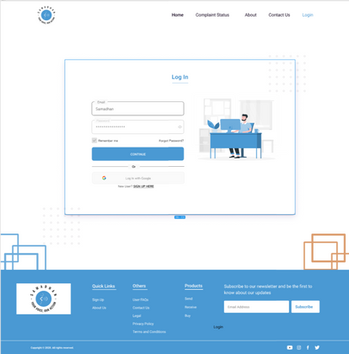
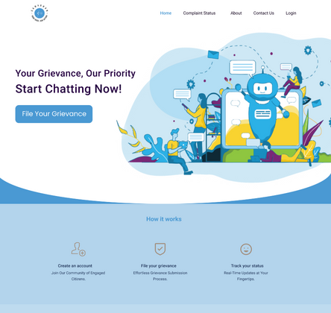
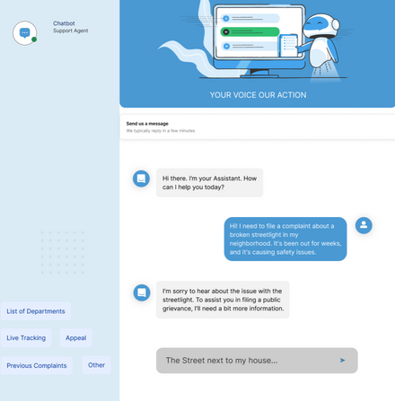
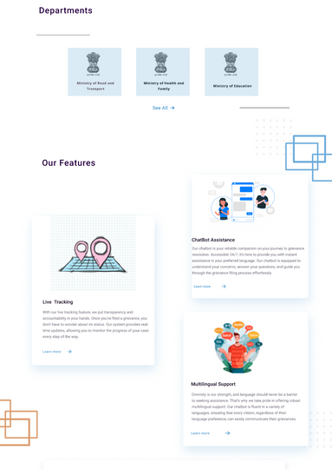
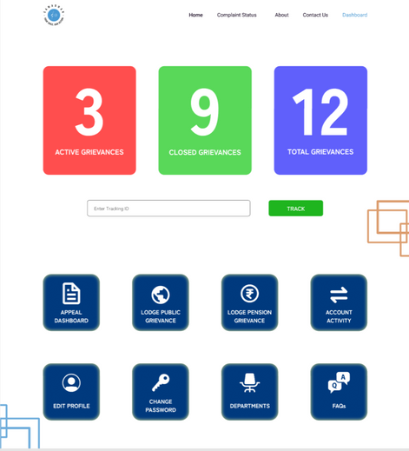



LAYOUT
Data Flow
website-UI
Providers
Processed Data
Repository
API
Models
Database
Flow
prototype:-
https://www.figma.com/file/yAq4SozPctg1tG5ijInp8T/Public-Grievance-Website?type=design&node-id=0-1&mode=design&t=mlBMAeS8Ew2gusSd-0

Slide 4
















TECHNOLOGY STACK
The primary objective of this initiative is to proactively address and rectify issues impacting the general populace. The platform is designed to empower authorities with a sophisticated framework, facilitating expeditious access to and resolution of complaints. Furthermore, it serves as a pivotal tool for the expeditious identification of emergency situations, allowing authorities to take decisive and immediate action. In circumstances necessitating interdepartmental collaboration, the platform ensures a seamless and efficient coordination, thereby enhancing the overall responsiveness of the authorities.
Database
web page
Mobile
API
Server
Documents
FEATURES
Quick Department Selection
Dependencies
Grievance Support System Functioning
Live Status
Multilanguage Support
Basic system with internet support
Goverment
Grievance database access
Ai
&
ML
Aadhar
API
Tutorials
TEAM MEMBER DETAILS
TEAM LEADER NAME: MEGHA JAIN
BRANCH : B.TECH STREAM : CS YEAR: III
TEAM MEMBER 2 : AVNISH KUMAR
BRANCH : B.TECH STREAM : CS YEAR: III
TEAM MEMBER 3 : SHABD SAHAY
BRANCH : B.TECH STREAM : CS YEAR: III
TEAM MENTOR NAME : MS. REKHA BAGHEL
CATEGORY : ACADEMIC DOMAIN : MACHINE LEARNING EXPERIENCE:
TEAM MEMBER 4 : NIKITA SHARMA
BRANCH : B.TECH STREAM : CS YEAR: III
TEAM MEMBER 5 : ASHISH SINGH
BRANCH : B.TECH STREAM : CSE YEAR: III
TEAM MEMBER 6 : SHREYANSH SACHAN
BRANCH : B.TECH STREAM : CSE(DS) YEAR: III

